Slide 1
Stochastic Process Model and Its Applications to Analysis of Longitudinal Data ACM-BCB 2017, Boston, MA 08/20/2017
Ilya Zhbannikov
Konstantin Arbeev
Anatoliy Yashin
Duke University, Social Science Research Institute

Slide 2
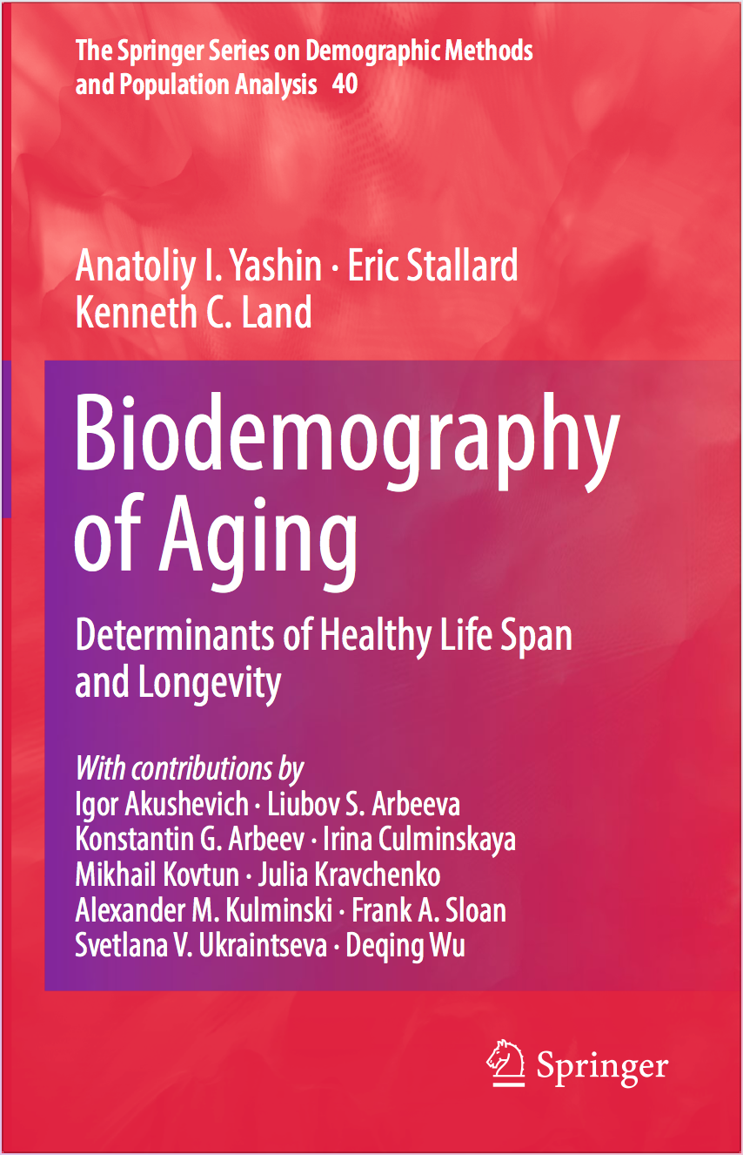
Synopsis
Goals and objectives
Part 1
Background
Methods
Part 2
R package stpm
Examples
Conclusions
This tutorial is also available from: https://github.com/izhbannikov/ACMBCB2017_SPM_Tutorial

Slide 3
Goals and objectives
Present the Stochastic Process Model (SPM) and discuss its applicability to different research areas.
Describe software tools and provide practical examples of joint analysis of time-to-event outcomes and longitudinal measurements.
Present several model extensions: partially observed covariates (e.g. genetics), multiple imputation.
Establish connections with those who are interested in working with Stochastic Process Model.
Notes:
: health studies, genetics, reliability theory
, which can be useful for those who work with longitudinal and genetic data.

Slide 4
Goals and objectives
After attending this tutorial session, participants:
Will learn how to jointly analyze time-to-event and longitudinal outcomes using the Stochastic Process Model approach.
Will be able to work with the R package stpm – a tool to estimate model parameters.
Will be provided with examples of analyses of data using SNPs from genes showing pleiotropic effects on different aging-related traits.
Will be provided with examples of techniques of longitudinal data imputation with stpm R package.

Slide 5
Part 1
Background
Methods

Slide 6
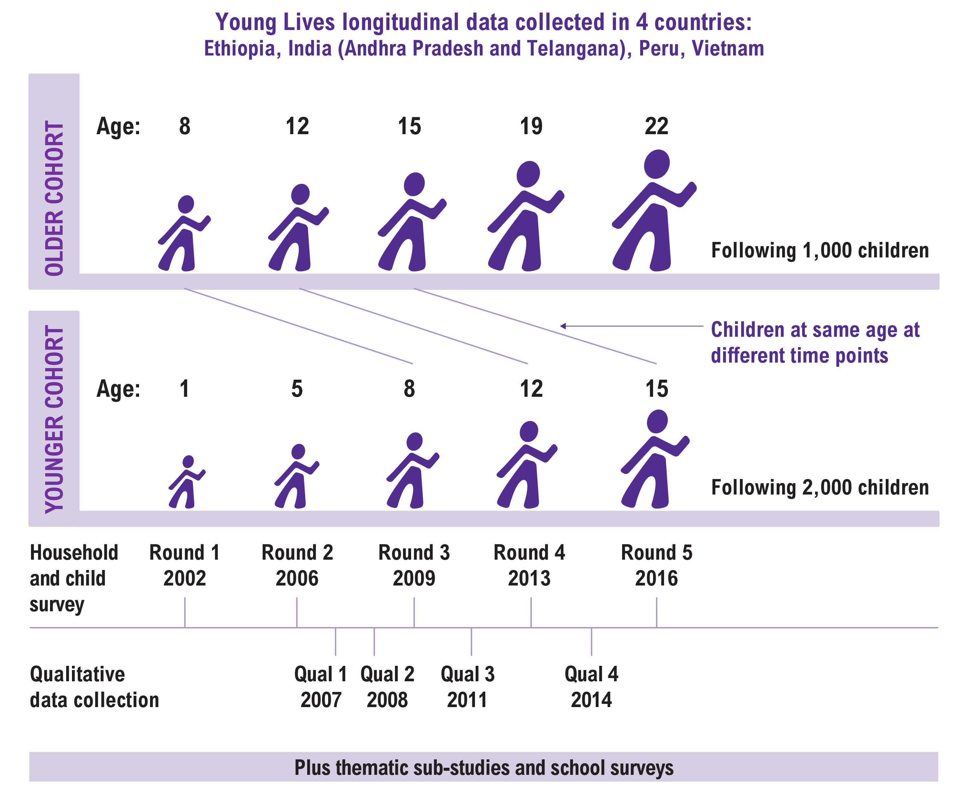
Stochastic Process Model: background
Longitudinal studies collect various types of outcomes (time-to-event, longitudinal outcomes, such as biomarkers, and other covariates).
To analyze this information, special statistical methods are needed.
One of the standard approaches would be the Cox model with time-dependent covariates but it may provide biased results (Prentice, 1982; Sweeting & Thompson, 2011).
© https://www.younglives.org.uk/content/our-research-methods
Notes:
Related time-to-event – mortality or system failure.

Slide 7
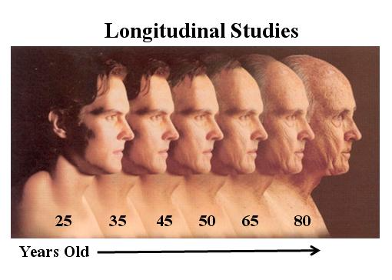
Stochastic Process Model: background
The Stochastic Process Model (SPM) is a general framework for joint analysis of time-to-event outcomes and repeatedly measured variables (covariates).
SPM incorporates knowledge about processes developing over time in system under study which involves deterioration, aging and other kinds of decay and related time-to-event.
SPM allows for evaluating mechanisms that indirectly affect longitudinal trajectories of physiological covariates and health and survival outcomes.
© www.asan-au.org
Notes:
Related time-to-event – mortality or system failure.

Slide 8
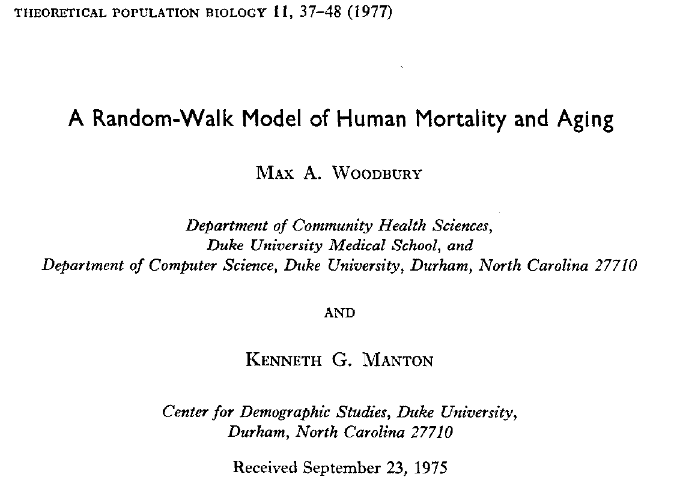
Stochastic Process Model: background
History
Woodbury & Manton (1977): “Random Walk Model of Human Mortality and Aging”.
Notes:
They developed a mathematical model that describes mechanisms of physiological aging and mortality in human organism.
An aging is represented in changes of vector of physiological variables (biomarkers, covariates) that describe the state of an organism.

Slide 9
Stochastic Process Model: background
dx_{ω}(t) = u(x_{ω},t)dt + dξ(x_{ω},t)
dP(x_{ω}) = μ(x_{ω},t)P(x_{ω})dt
dx_{ω}(t) – changes in physiological variable during time dt
u(x_{ω},t) – deterministic effects
dξ(x_{ω},t) – random walk term
P(x_{ω}) – probability of surviving
The organism is positioned in a state space of physiological variables.
This model can also be used for description and analysis of changes in technical systems.
The process of aging is represented by changes in an organism’s position in physiological state space.
Such changes tend to carry the organism into regions of state space which are characterized by probabilities of death μ(x_{ω},t)dt greater than in its previous position.
(1)
(2)
Notes:
Determenistic effect are some physiological regularities describing aging-relating changes, In case of technical systems it can be some functions (regularities) of their deterioration. Ксай – не зависит от x (иначе теряется гауссовость) и может быть каким угодно в рамках модели.

Slide 10
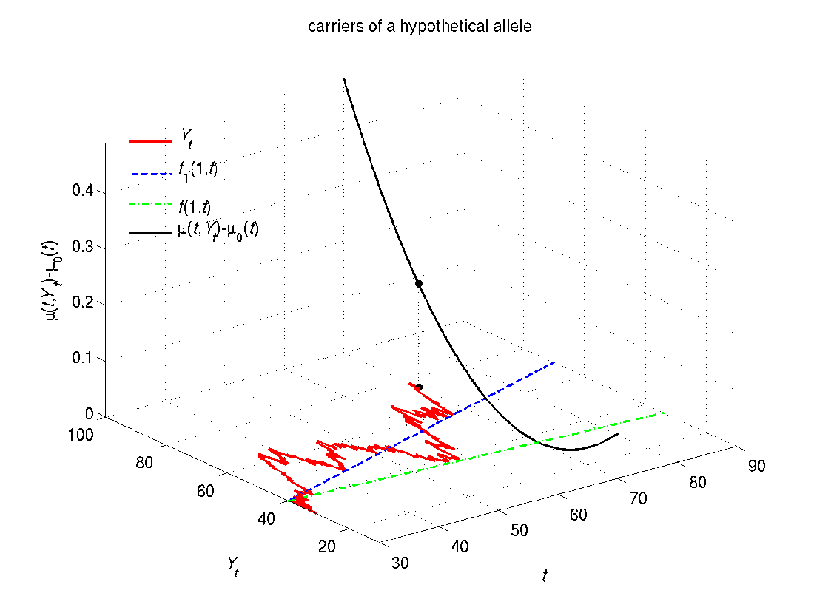
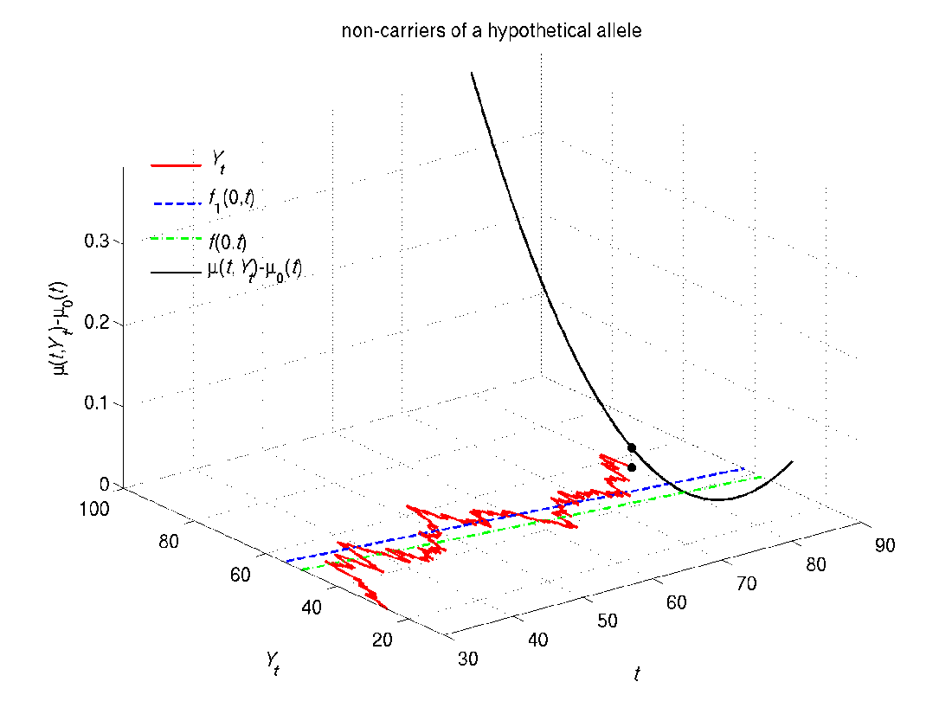
age-specific physiological “norms” corresponding to the minimal mortality risk at respective ages
increase in the mortality risk at age t and value Y_{t} compared to the baseline level at this age (µ₀(t))
mean allostatic state that the trajectory of Y_{t} is forced to follow
quadratic hazard term at age t
Schematic illustration of SPM: Increase in mortality risks compared to the baseline mortality (corresponds to zero level) for carriers and non-carriers of a hypothetical allele (t is age and Y_{t} is the value of a hypothetical physiological variable at this age)

Slide 11
Stochastic Process Model: background
Woodbury & Manton introduced the quadratic hazard.
This was convenient because the system dynamics can be described in terms of multi-dimensional Gaussian distribution under some conditions (initial: Gaussian distribution, linear stochastic process and Wiener random process).
Later this model was extended to take into account some fundamental processes related to system deterioration, aging or decay.
In application to analyzing human aging, health and longevity, these fundamental processes include age-dependent physiological norm, stress-resistance, adaptive capacity, allostatic adaptation and allostatic load.
Notes:
В основе новой (2007) модели лежат две вещи: dynamic of aging (deterioration) and survival outcome (i.e. event).
Вначале были лайф таблицы и задавались вопросами что такое старение. Начали измерять некоторые характеристики с возрастом. Биодемографы связали физиологические характеристики с лайф таблами (модел Strechler-Mildwan).
Illustration of hypothetical two-dimensional U-shaped mortality risks (quadratic hazards) considered as a function of two risk factors Y1x and Y2x (e.g., physiological variables) for the 30 and 80 years old individuals. (by A.I. Yashin, 2015)

Slide 12
Stochastic Process Model: methods
Age dynamics of a physiological variable Y (a dynamic component of the extended model*):
dY(t) = a(t)(Y(t) – f₁(t))dt + b(t)dW(t), Y(t = t₀)
a(t) – adaptive capacity
f₁(t) – average allostatic trajectory
b(t) – strength of random disturbances
W(t) – Wiener process
* © Yashin A.I., et al., Stochastic model for analysis of longitudinal data on aging and mortality, Mathematical Biosciences, Volume 208, Issue 2, August 2007, Pages 538-551, ISSN 0025-5564.
Notes:
Here in this equation, Y(t) is a k × 1 matrix, where k is a number of covariates, which is a model dimension) describing the value of a physiological variable at a time (e.g. age) t. f₁(Z, t) is a k × 1 matrix that corresponds to the long-term average value of the stochastic process Y(t), which describes a trajectory of individual variable influenced by different factors represented by a random Wiener process W(t). The negative feedback coefficient a(Z, t) (k × k matrix) characterizes the rate at which the stochastic process goes to its mean. In research on aging and well-being, f₁(Z, t) represents the average allostatic trajectory and a(t) in this case represents the adaptive capacity of the organism. Coefficient b(Z, t) (k × 1 matrix) characterizes a strength of the random disturbances from Wiener process W(t). All of these parameters depend on Z (a genetic marker having values 1 or 0).
The following function μ(t, Y(t)) represents a hazard rate:
μ(t, Y(t)) = μ₀(t) + (Y(t) - f(Z, t))*Q(Z, t)(Y(t) - f(Z, t)), (2)
In this equation: μ₀(t) is the baseline hazard, which represents a risk when Y(t) follows its optimal trajectory; f(t) (k × 1 matrix) represents the optimal trajectory that minimizes the risk and Q(Z, t) (k x k matrix) represents a sensitivity of risk function to deviation from the norm. In general, model coefficients a(Z, t), f₁(Z, t), Q(Z, t), f(Z, t), b(Z, t) and μ₀(t) are time(age)-dependent. For example, the coefficient a can be assumed as (i) -0.05 (a constant, time-independent, one-dimensional model) or (ii) a(t) = a₀ + b₀t (time-dependent), in which a₀ and b₀ are unknown parameters to be estimated. Presented model can handle, in theory, any number of physiological variables, however using many variables may lead to extensive usage of computational resources. Symbol ‘*’ denotes transpose operation.
In order to estimate coefficients a(Z, t), f₁(Z, t), Q(Z, t), f(Z, t), b(Z, t) and μ₀(t) which are the parameters of stochastic process, a method of maximizing likelihood is used (the actual likelihood equations are described in the next section).

Slide 13
Stochastic Process Model: methods
A hazard component (e.g. a risk to die, mortality risk):
μ(t, Y(t)) = μ₀(t) + (Y(t) – f(t))^{T}Q(t)(Y(t) – f(t))
f(t) – optimal trajectory that minimizes the risk.
Q(t) – stress resistance (represents deviation from the norm).
μ₀(t) – baseline hazard.
© Yashin A.I., et al., Stochastic model for analysis of longitudinal data on aging and mortality, Mathematical Biosciences, Volume 208, Issue 2, August 2007, Pages 538-551, ISSN 0025-5564.
Notes:
Here in this equation, Y(t) is a k × 1 matrix, where k is a number of covariates, which is a model dimension) describing the value of a physiological variable at a time (e.g. age) t. f₁(Z, t) is a k × 1 matrix that corresponds to the long-term average value of the stochastic process Y(t), which describes a trajectory of individual variable influenced by different factors represented by a random Wiener process W(t). The negative feedback coefficient a(Z, t) (k × k matrix) characterizes the rate at which the stochastic process goes to its mean. In research on aging and well-being, f₁(Z, t) represents the average allostatic trajectory and a(t) in this case represents the adaptive capacity of the organism. Coefficient b(Z, t) (k × 1 matrix) characterizes a strength of the random disturbances from Wiener process W(t). All of these parameters depend on Z (a genetic marker having values 1 or 0).
The following function μ(t, Y(t)) represents a hazard rate:
μ(t, Y(t)) = μ₀(t) + (Y(t) - f(Z, t))*Q(Z, t)(Y(t) - f(Z, t)), (2)
In this equation: μ₀(t) is the baseline hazard, which represents a risk when Y(t) follows its optimal trajectory; f(t) (k × 1 matrix) represents the optimal trajectory that minimizes the risk and Q(Z, t) (k x k matrix) represents a sensitivity of risk function to deviation from the norm. In general, model coefficients a(Z, t), f₁(Z, t), Q(Z, t), f(Z, t), b(Z, t) and μ₀(t) are time(age)-dependent. For example, the coefficient a can be assumed as (i) -0.05 (a constant, time-independent, one-dimensional model) or (ii) a(t) = a₀ + b₀t (time-dependent), in which a₀ and b₀ are unknown parameters to be estimated. Presented model can handle, in theory, any number of physiological variables, however using many variables may lead to extensive usage of computational resources. Symbol ‘*’ denotes transpose operation.
In order to estimate coefficients a(Z, t), f₁(Z, t), Q(Z, t), f(Z, t), b(Z, t) and μ₀(t) which are the parameters of stochastic process, a method of maximizing likelihood is used (the actual likelihood equations are described in the next section).

Slide 14
Stochastic Process Model: background
Illustration of hypothetical two-dimensional U-shaped mortality risks considered as a function of two risk factors Y1x and Y2x for the 30 and 80 years old individuals. (by A.I. Yashin, 2015)
Notes:
Illustration of hypothetical two-dimensional U-shaped mortality risks (quadratic hazards) considered as a function of two risk factors Y1x and Y2x (e.g., physiological variables) for the 30 and 80 years old individuals. (by A.I. Yashin, 2015)

Slide 15
Part 2
Software
R package stpm
Practical examples
Quick start
Data simulation
Genetic SPM
Multiple imputation of longitudinal data

Slide 16
R-package stpm
Developed for:
Data simulation and estimating the model parameters under different scenarios (no genetic effects considered)
Estimating genetic effects using joint analysis of longitudinal, mortality and genetic data.
Multiple imputation of longitudinal data.
First publicly available software that implements Stochastic Process Model methodology.
Notes:
Model is ok but it is only a theory
There are some custom Matlab and SAS scripts which allow to test the model an corresponding hyphoteses
But there were no publicly available tool that will allow researchers use the benefits of the SPM
Therefore I and my co-workers (Igor, Konstantin and Anatoliy) developed an R-package ‘stpm’
Stpm is available from CRAN (stable version) or from my github repository.

Slide 17
R-package stpm
R-package stpm is available from the following links:
https://cran.r-project.org/web/packages/stpm/index.html (stable)
https://github.com/izhbannikov/spm/ (most-recent)

Slide 18
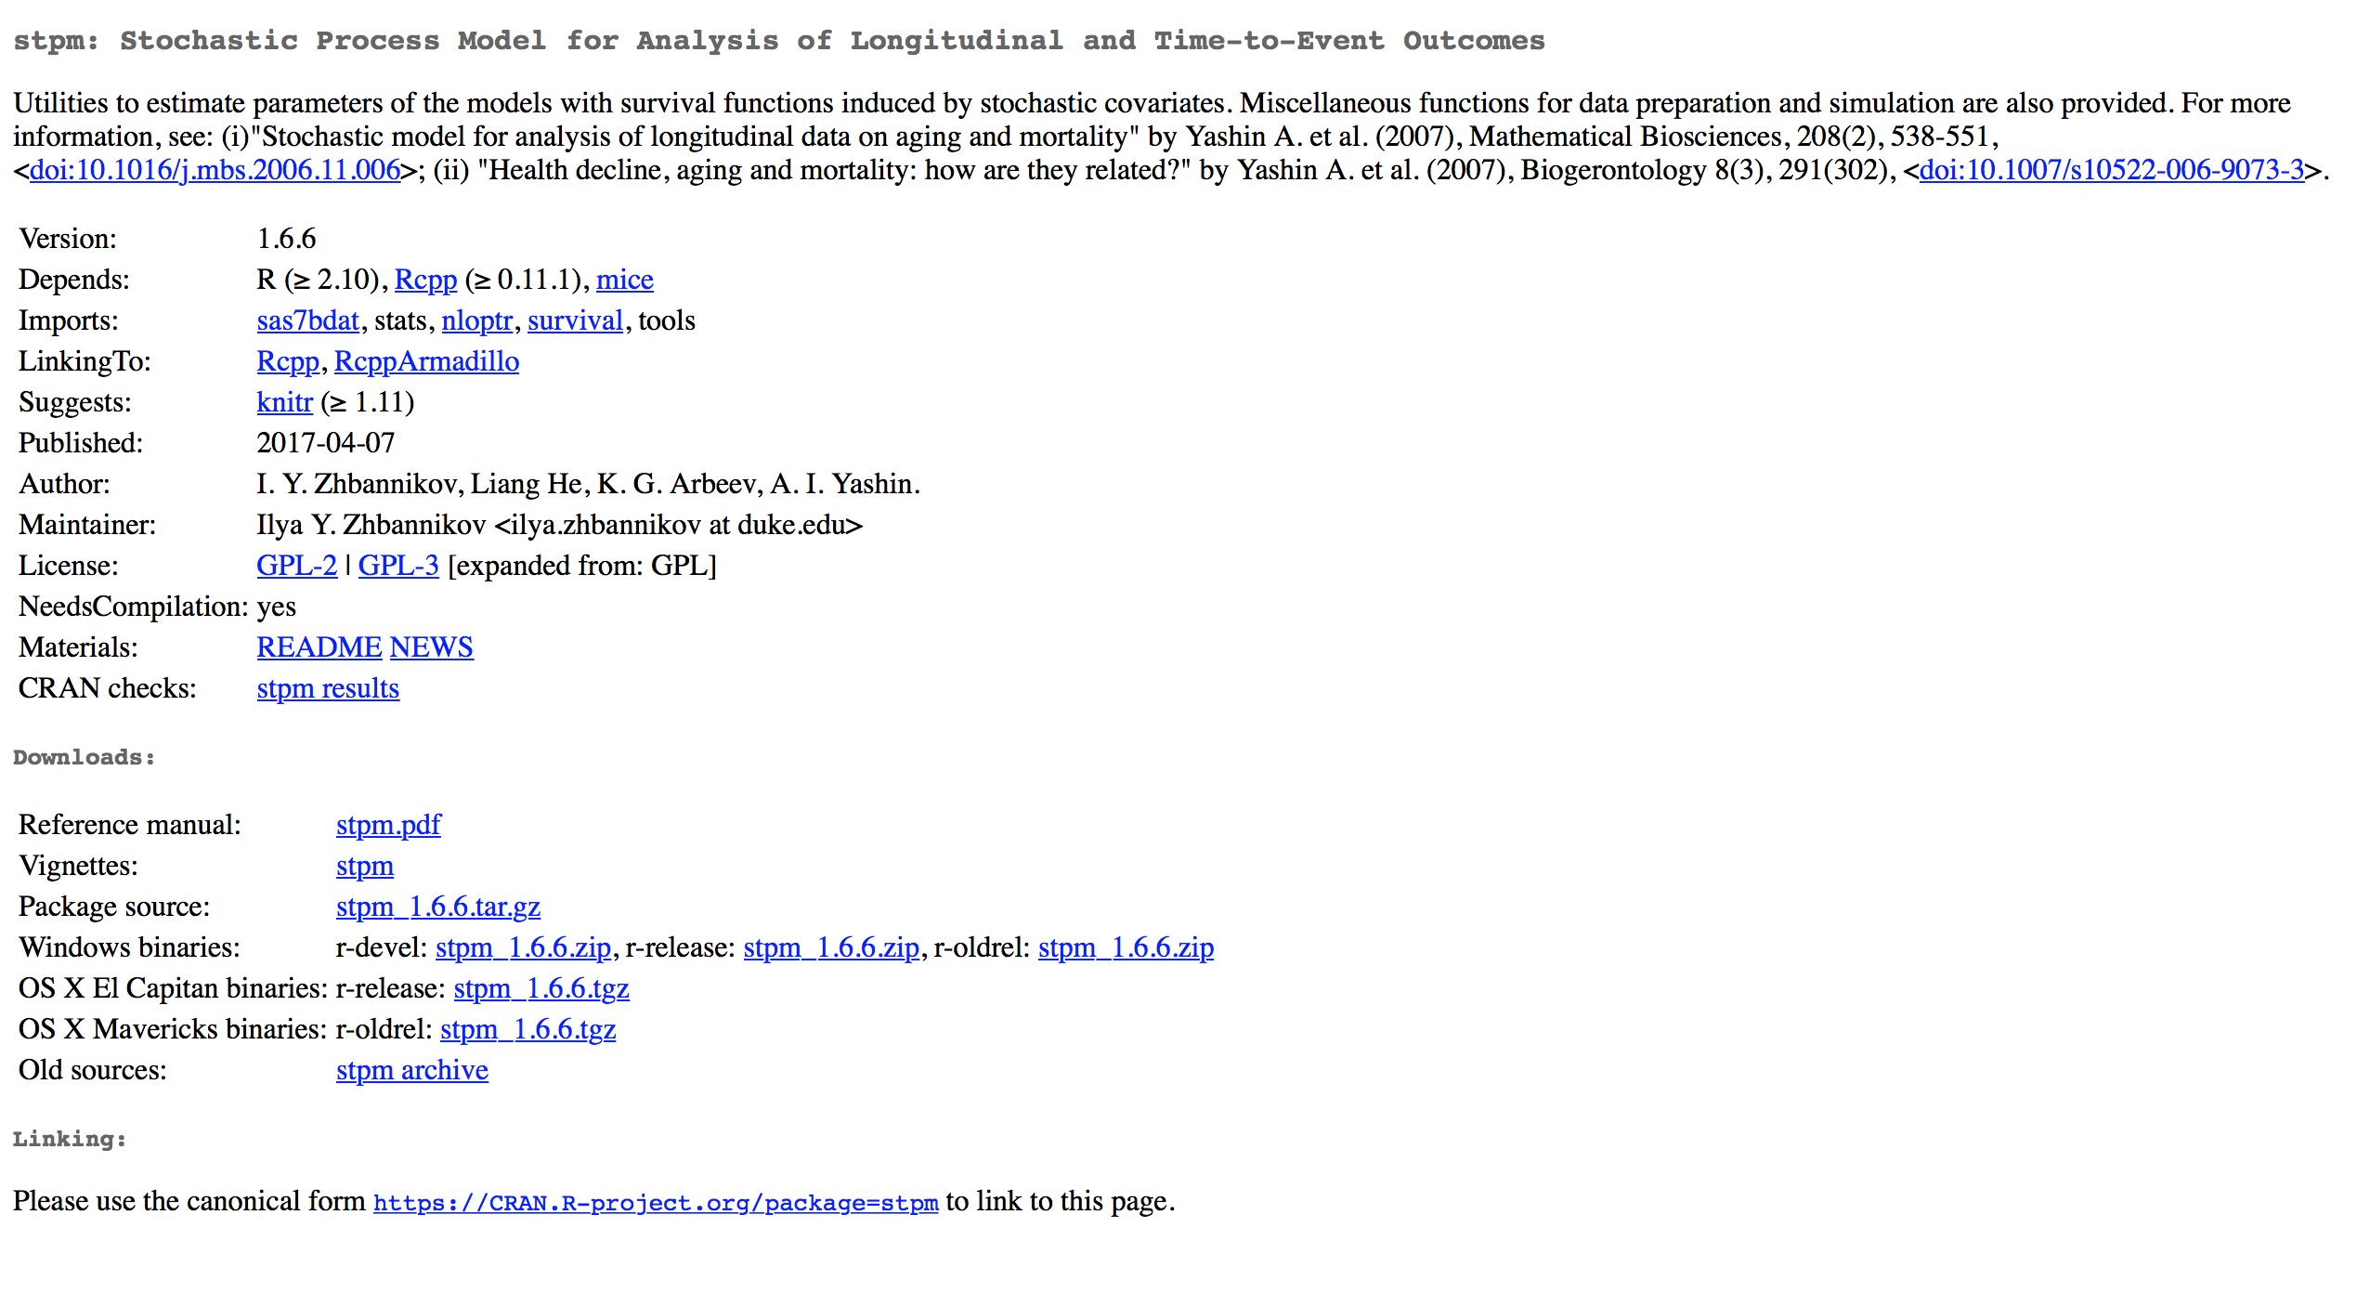
R-package stpm
https://cran.r-project.org/package=stpm

Slide 19
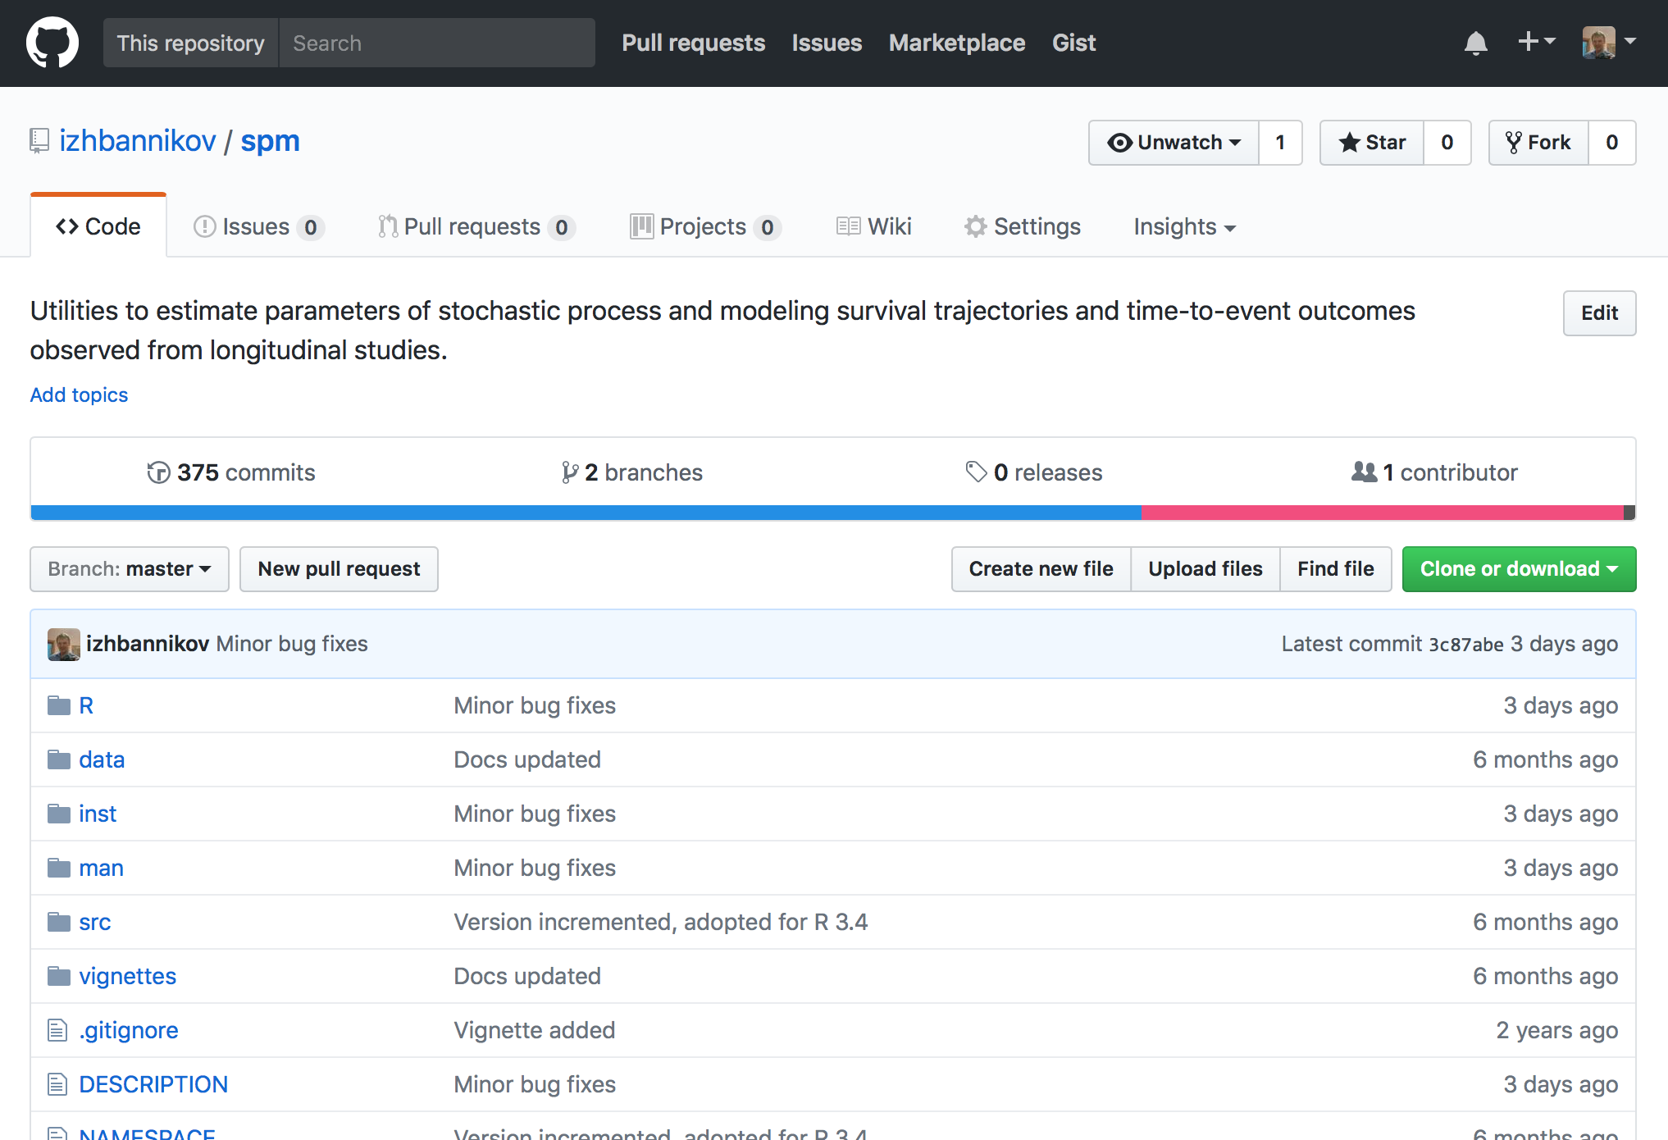
R-package stpm
https://github.com/izhbannikov/spm

Slide 20
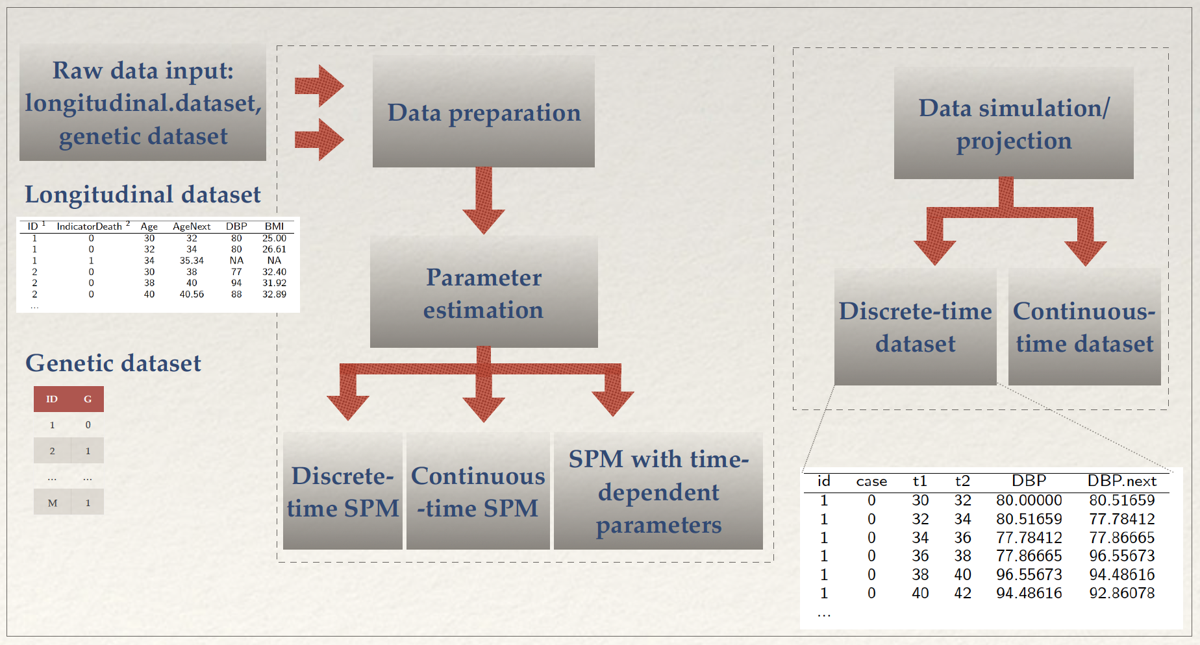
R-package stpm
Notes:
Сделать крупнее таблицу 1.
Longitudinal
A subject identification number
2 IndicatorDeath shows that death occurred (IndicatorDeath=1) or did not occur (IndicatorDeath=0) between Age and AgeNext. Age for the next observation of the same individual must coincide with AgeNext of the current observation. AgeNext is a censoring age for the last observation.
3 DBP and BMI are measured at age Age and are diastolic blood pressure and body mass index. They are covariates. If some values of covariates are missing (but the subject is alive), they are imputed on the data preparation stage (see section ”Data preparation”).
Vital statistics
1 LSmort is the actual
age of death for IsDead=1
and the age at censoring
for IsDead=0. LSmort is
equal AgeNext from
Table 1 for the last record
of individual.

Slide 21

Examples
Please clone or download them from the tutorial page:
https://github.com/izhbannikov/ACMBCB2017_SPM_Tutorial

Slide 22
Package installation
#Example1.R
install.packages("stpm")
#OR
library(devtools)
install_github("izhbannikov/spm")

Slide 23
Examples
Typical analysis workflow:
Prepare data
Estimate parameters
Make conclusions
Notes:
This typical analysis workflow does not include the data simulation – since it is separate workflow.

Slide 24
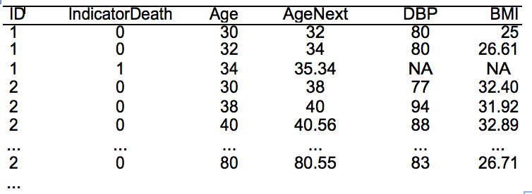
Input data
Notes:
Longitudinal
A subject identification number
2 IndicatorDeath shows that death occurred (IndicatorDeath=1) or did not occur (IndicatorDeath=0) between Age and AgeNext. Age for the next observation of the same individual must coincide with AgeNext of the current observation. AgeNext is a censoring age for the last observation.
3 DBP and BMI are measured at age Age and are diastolic blood pressure and body mass index. They are covariates. If some values of covariates are missing (but the subject is alive), they are imputed on the data preparation stage (see section ”Data preparation”).
Vital statistics
1 LSmort is the actual
age of death for IsDead=1
and the age at censoring
for IsDead=0. LSmort is
equal AgeNext from
Table 1 for the last record
of individual.

Slide 25
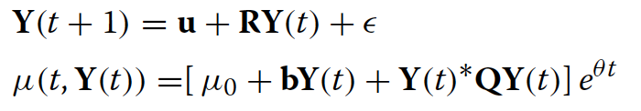
Discrete-time SPM*
u, R, μ₀, b, Q and 𝛆 (t) are assumed to be constant and reflect coefficients in the first model form.
The Gompertz hazard is used and the parameter 𝜃 is to be estimated along with other parameters.
* Akushevich, I., et al., Life Tables with Covariates: Dynamic Model for Nonlinear Analysis of Longitudinal Data, Mathematical Population Studies, 12(2):51-80, 2005.
Notes:
Заменить ссылку – вместо Акушевича сослаться на другую статью. И убрать этот слайд ниже, там где будет пример. Исправить e на e(t) в формуле.

Slide 26
Quick start
#Example2.R
#Quick start
library(stpm)
# Let's take a look at raw data
raw.data <- read.csv(system.file("extdata", "longdat.csv", package="stpm"))
#Prepare data for optimization
data <- prepare_data(x=system.file("extdata", "longdat.csv", package="stpm"))
#Estimate parameters
#(default model: discrete-time):
p.discr.model <- spm(data)
# Continuous-time model:
p.cont.model <- spm(data, model="continuous”)

Slide 27
Code example
#Example3.R
#Model with time-dependent parameters
library(stpm)
# Reading raw data
raw.data <- read.csv(system.file("extdata", "longdat.csv", package="stpm"))
head(raw.data)
#Prepare data for optimization
data <- prepare_data(x=system.file("extdata", "longdat.csv", package="stpm"),
col.id = "ID", col.status = "IndicatorDeath",
col.age = "Age",
covariates = "DBP",
impute=FALSE)
pars <- spm_time_dep(x=data[[1]],
start = list(a = -0.05, f1 = 80, Q = 2e-08, f = 80,
b = 5, mu0 = 0.001),
frm = list(at = "a", f1t = "f1", Qt = "Q",
ft = "f", bt = "b", mu0t = "mu0"))

Slide 28
Code example
#Example4.R
library(stpm)
# Simulation
# Data simulation:
data <- spm_projection(model.par, N=5000,ystart=80, model="discrete”)
# Print some data:
head(data$data)
# Mean of covariates by age:
data$stat$mean.by.age
# Plot survival probabilities:
plot(data$stat$srv.prob, xlab=“Years",ylab="Percent survival")

Slide 29
Code example (cont.)
#Example4.R (cont)
ff <- list(at="-0.001*t+.05",
f1t="60",
Qt="2e-8",
ft="80",
bt="5",
mu0t="1e-3")
dat <- simdata_time_dep(N=1000, f=ff)

Slide 30
Illustration of hypothetical two-dimensional U-shaped mortality risks considered as a function of two risk factors Y1x and Y2x for the 30 and 80 years old individuals. (by A.I. Yashin, 2015)
Notes:
Illustration of hypothetical two-dimensional U-shaped mortality risks (quadratic hazards) considered as a function of two risk factors Y1x and Y2x (e.g., physiological variables) for the 30 and 80 years old individuals. (by A.I. Yashin, 2015)

Slide 31
Extensions: Genetic SPM (GSPM)
A categorical variable Z = {0, 1}, which represents carriers/non-carriers of some allele.
Assume that P(Z=1) = p, p ∈ [0, 1], where p is is the proportion of carriers and non-carriers of an allele in a population.
dY(t) = a(Z, t)(Y(t) – f₁(Z, t))dt + b(Z, t)dW(t), Y(t = t₀)
μ(t, Y(t)) = μ₀(t) + (Y(t) - f(Z, t))*Q(Z, t)(Y(t) - f(Z, t))
Notes:
GenSPM, presented in 2009 by Arbeev at al [10] and further elaborated in [22, 23], extends the basic stochastic process model conception by introducing a categorical variable, Z, which may be a specific value of a genetic marker or, in general, any categorical variable. Currently, Z is presented in two gradations: 0 or 1 in a genetic group of interest, assuming that P(Z=1) = p, p ∈ [0, 1], were p is the proportion of carriers and non-carriers of an allele in a population. Example of longitudinal data with genetic component Z is provided in Table 1. In the previous study, the GenSPM model was verified on a single physiological variable but its behavior if more than one variable used is not known. The general concern is that using a single variable may not be enough for performing comprehensive hypotheses evaluations.

Slide 32
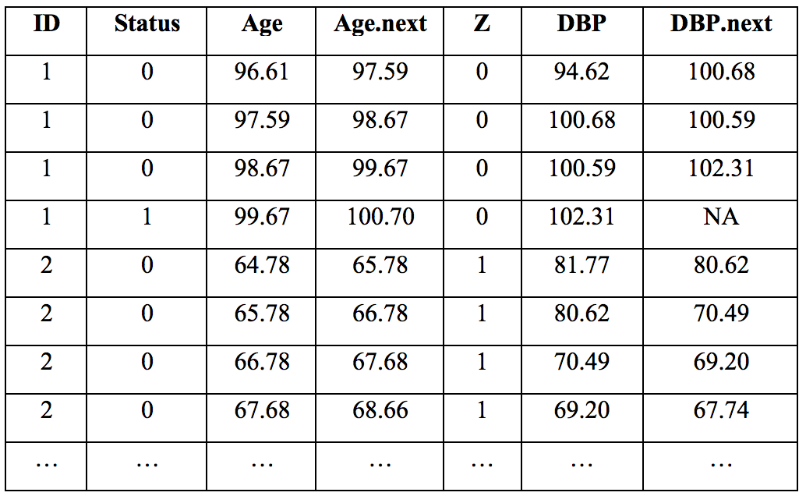
Extensions: Genetic SPM (GSPM)
Notes:
Example of longitudinal data with genetic component Z presented as a dichotomous value of some genetic marker (Z = 1 for carriers and 0 for non-carriers). Here “ID” is a person’s identification number in a database; “Status” represents death (1) or censoring (0) of an individual at age “Age.next”; “DBP” is a physiological variable, which is diastolic blood pressure in this example.

Slide 33
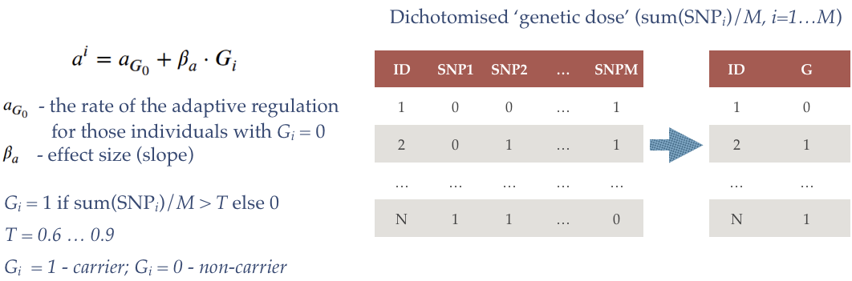
Extensions: Genetic SPM (GSPM)
(Z = G)
Notes:
Example of longitudinal data with genetic component Z presented as a dichotomous value of some genetic marker (Z = 1 for carriers and 0 for non-carriers). Here “ID” is a person’s identification number in a database; “Status” represents death (1) or censoring (0) of an individual at age “Age.next”; “DBP” is a physiological variable, which is diastolic blood pressure in this example.

Slide 34
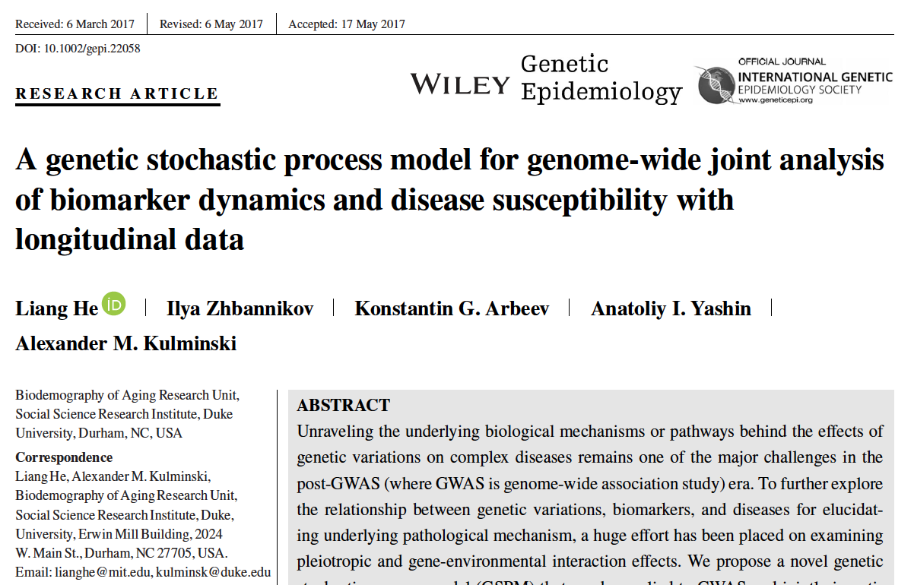
Extensions: Genetic SPM (GSPM)
Notes:
Example of longitudinal data with genetic component Z presented as a dichotomous value of some genetic marker (Z = 1 for carriers and 0 for non-carriers). Here “ID” is a person’s identification number in a database; “Status” represents death (1) or censoring (0) of an individual at age “Age.next”; “DBP” is a physiological variable, which is diastolic blood pressure in this example.

Slide 35
Code example
#Example5.R
#Evaluating genetic effects
library(stpm)
data(ex_spmcon1dg)
res <- spm_con_1d_g(ex_data$spm_data, ex_data$gene_data,
a = -0.02, b=0.2, q=0.01, f=3, f1=3,
mu0=0.01, theta=1e-05,
upper=c(-0.01,3,0.1,10,10,0.1,1e-05),
lower=c(-1,0.01,0.00001,1,1,0.001,1e-05),
effect=c('q'))
res

Slide 36
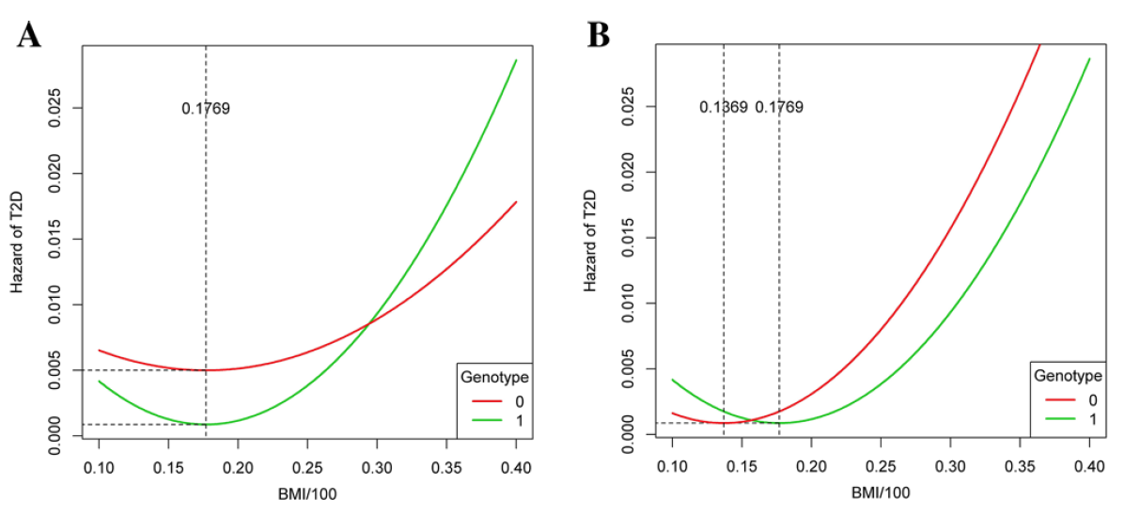
Comparison of the hazard functions in the two genotype groups with different 𝑓, but with the same 𝜇₀ and 𝑞. This is the model used in the GWAS for detecting the BMI frailty threshold on T2D. This is performed by testing whether 𝑓 is different across genotype groups with 𝜇₀ and 𝑞 shared by the genotype groups (SNPs: rs1551133 and rs2613310; Data: Atherosclerosis Risk in Communities study (ARIC), 8,234 individuals).
@ He et al, “A genetic stochastic process model for genome-wide joint analysis of biomarker dynamics and disease susceptibility with longitudinal data”, 2017

Slide 37
Multiple imputation
The SPM offers longitudinal data imputation
It “preserves” data structure, i.e. relationships between Y(t) and mu(Y(t),t).
Below there are two examples of multiple data imputation with function spm.impute(...).
Notes:
based on conditional Gaussian property: T > t. (include equations for m and gamma.)

Slide 38
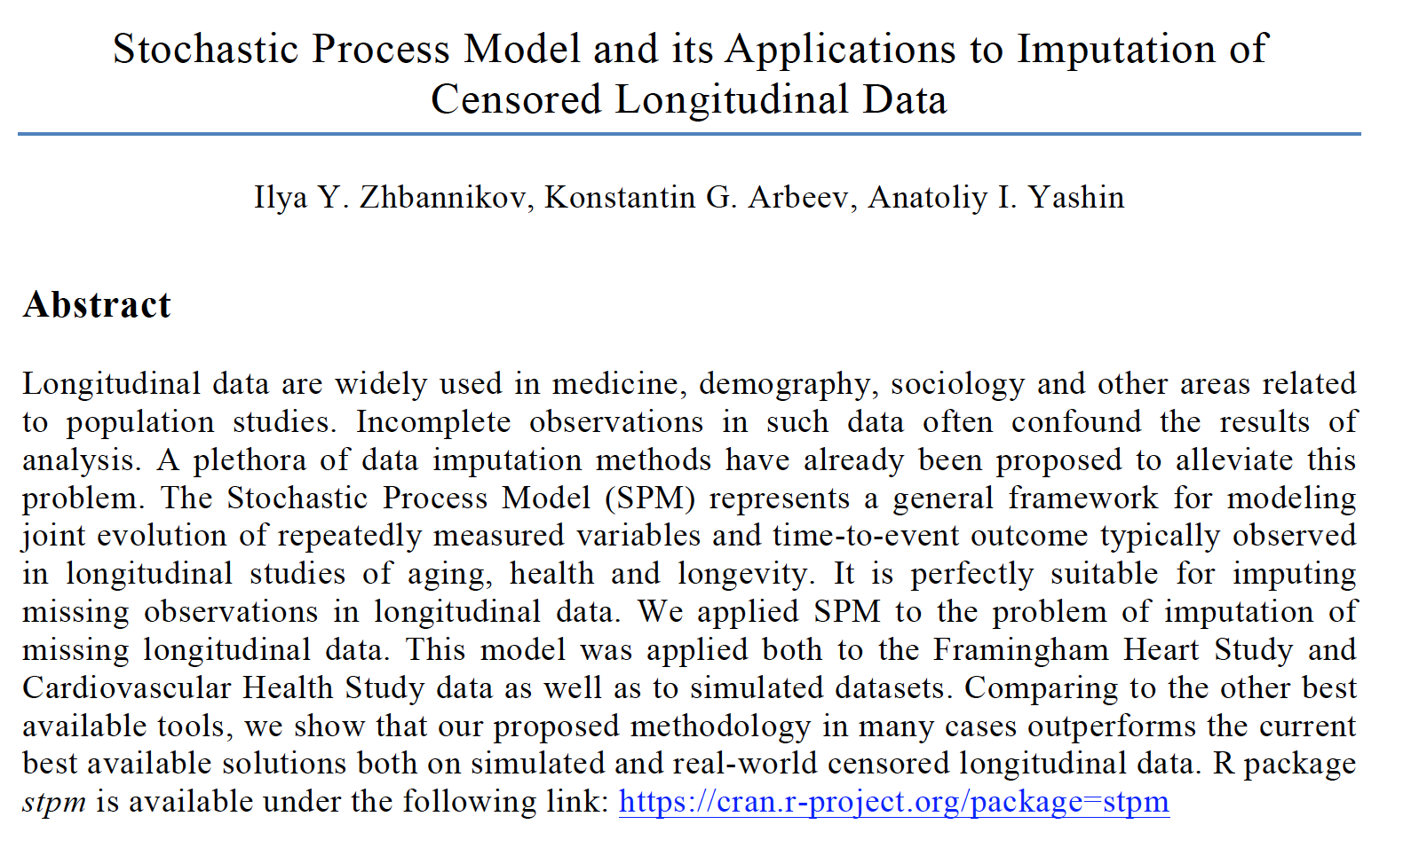
Zhbannikov et al (2017), Stochastic Process Model and its Applications to Imputation of Censored Longitudinal Data, PAA 2017, Chicago, USA.

Slide 39
Code example
#Example6.R
library(stpm)
############## One dimensional case ###################
# Data preparation #
data <- simdata_discr(N=1000, dt = 2)
miss.id <- sample(x=2:dim(data)[1], size=round(dim(data)[1]/4)) # ~25% missing data
incomplete.data <- data
incomplete.data[miss.id,5] <- NA; incomplete.data[miss.id-1,6] <- NA
# End of data preparation #
# Estimate parameters from the complete dataset #
p <- spm_discrete(data, theta_range = seq(0.075, 0.09, by=0.001))
##### Multiple imputation with SPM #####
imp.data <- spm.impute(dataset=incomplete.data, minp=5, theta_range=seq(0.075, 0.09, by=0.001))$imputed
# Estimate SPM parameters from imputed data and compare them to the p:
pp.test <- spm_discrete(imp.data, theta_range = seq(0.075, 0.09, by=0.001))
pp.test

Slide 40
Code example
#Example7.R
library(stpm)
################ Two-dimensional case ###################
# Parameters for data simulation #
a <- matrix(c(-0.05, 0.01, 0.01, -0.05), nrow=2); f1 <- matrix(c(90, 30), nrow=1, byrow=FALSE)
Q <- matrix(c(1e-7, 1e-8, 1e-8, 1e-7), nrow=2); f0 <- matrix(c(80, 25), nrow=1, byrow=FALSE)
b <- matrix(c(5, 3), nrow=2, byrow=TRUE)
mu0 <- 1e-04; theta <- 0.07
ystart <- matrix(c(80, 25), nrow=2, byrow=TRUE)
# Data preparation #
data <- simdata_discr(N=1000, a=a, f1=f1, Q=Q, f=f0, b=b, ystart=ystart, mu0 = mu0, theta=theta, dt=2)

Slide 41
Code example (cont.)
# Delete some observations in order to have approx. 25% missing data
incomplete.data <- data
miss.id <- sample(x=dim(data)[1], size=round(dim(data)[1]/4))
incomplete.data <- data
incomplete.data[miss.id, c(5,7)] <- NA
incomplete.data[miss.id-1,c(6,8)] <- NA
# End of data preparation #
# Estimate parameters from the complete data:
p <- spm_discrete(data, theta_range = seq(0.06, 0.08, by=0.001))
p
##### Multiple imputation with SPM #####
imp.data <- spm.impute(dataset=incomplete.data, minp=5, theta_range=seq(0.060, 0.08, by=0.001))$imputed
# Estimate SPM parameters from imputed data and compare them to the p:
pp.test <- spm_discrete(imp.data, theta_range = seq(0.060, 0.08, by=0.001))
pp.test

Slide 42
Conclusions
Stochastic Process Model is a powerful method for joint analysis of time-to-event and longitudinal outcomes.
R package stpm is first publicly available tool for which implements this methodology.
The approach found useful applications in research on aging and other fields in which time-to-event longitudinal outcomes are involved.
Applications of the model to genetic analysis are also available and is an active area of our research.

Slide 43
Acknowledgements
This work was supported by the National Institute on Aging of the National Institutes of Health (NIA/NIH) under Award Numbers P01AG043352, R01AG046860, and P30AG034424. The content is solely the responsibility of the authors and does not necessarily represent the official views of the NIA/NIH.

Slide 44
References
[1] Akushevich I., Kulminski A. and Manton K. 2005. Life tables with covariates: Dynamic model for Nonlinear Analysis of Longitudinal Data. Mathematical Population Studies, 12(2), pp.: 51-80.
[2] Arbeev, K.G., et al. 2009. Genetic model for longitudinal studies of aging, health and longevity and its potential application to incomplete data. Journal of Theoretical Biology. 258(1): p. 103-111.
[3] Manton K.G., Stallard E., Singer B.H. 1992. Projecting the future size and health status of the U.S. elderly population. Int J Forecast 8:433–458.
[4] Witteman J.C.M., Grobbee D.E., Valkenburg H.A. et al.,1994. J-shaped relation between change in diastolic blood pressure and aortic atherosclerosis. Lancet 343:504–507.
[5] Woodbury M.A., Manton K.G. 1977. Random-Walk of Human Mortality and Aging.. Theoretical Population Biology, 11:37-48.
[6] Yashin, A.I., Manton K.G., Vaupel J.W. 1985. Mortality and aging in a heterogeneous population: a stochastic process model with observed and unobserved variables. Theor Pop Biology, 27.
[7] Yashin, A.I., Manton, K.G., Stallard, E. 1986. Dependent competing risks: a stochastic process model, J. Math. Biol. 24, p: 119.
[8] Yashin, A.I. et al. 2007(a). Health decline, aging and mortality: how are they related? Biogerontology, 8(3), 291–302.
[9] Yashin, A.I. et al. 2007(b). Stochastic model for analysis of longitudinal data on aging and mortality. Mathematical Biosciences, 208(2), 538 – 551.
[10] Yashin A.I. et al. 2008. Model of hidden heterogeneity in longitudinal data. Theoretical Population Biology 73, pp. 1–10.

Slide 45
Contact
Ilya Zhbannikov, ilya.zhbannikov@duke.edu
Konstantin Arbeev, konstantin.arbeev@duke.edu
Anatoliy Yashin, aiy@duke.edu

